Slide 1
Occlusion Culling with Umbra
Zhang Heng

Slide 2
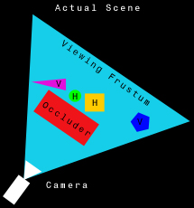
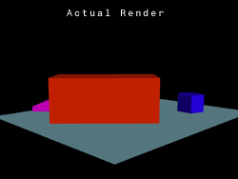
Occlusion Culling
Objects that are entirely behind other opaque objects may be culled

Slide 3
Occlusion Culling
Occlusion Query
A command passed to a Graphics processing unit requesting the testing of bounding volume geometry against the depth buffer to determine if any contents in the potentially visible set

Slide 4
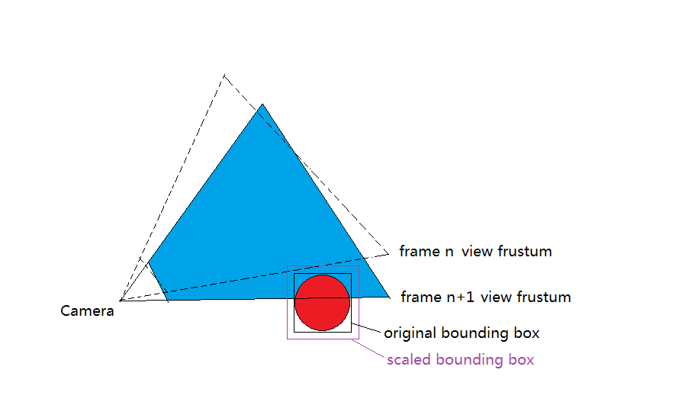
Occlusion Culling
Used in Game Engine
UE4
Use occlusion query, get query result in next frame. Objects may popping when camera rotate fast.

Slide 5
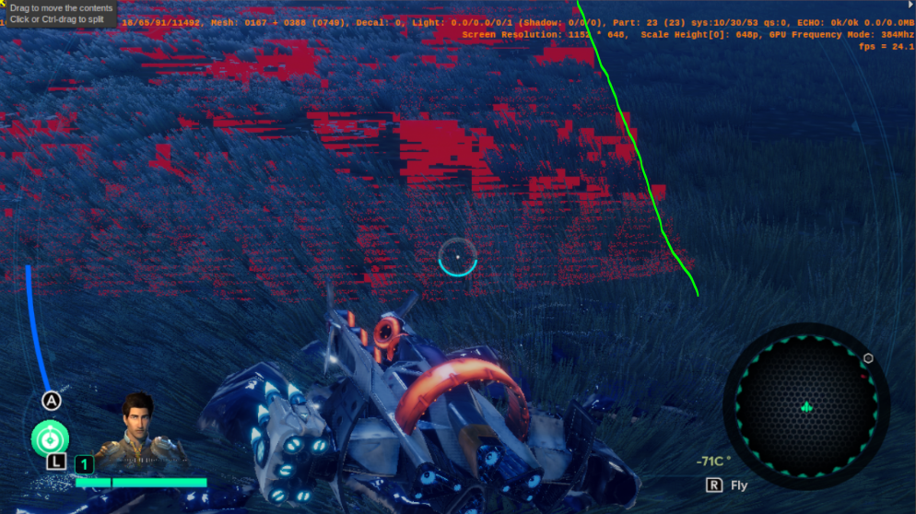
Occlusion Culling
Used in Game Engine
Snowdrop
Use occlusion query. reproject depth buffer from previous frame. The performance is not stable when camera rotate fast.

Slide 6
Umbra
Umbra is a graphics software technology company founded 2007 in Helsinki, Finland.
Umbra specializes in occlusion culling, visibility solution technology.
Umbra provides middleware for video games running on Windows, Linux, PlayStation 4, Xbox One, PlayStation 3, Xbox 360, handheld consoles, iOS, Wii U and other platforms.
Umbra provides the occlusion culling system for Unity game engine since Unity 3 release
Umbra is also available as a plug-in for Unreal Engine 3 and 4

Slide 7
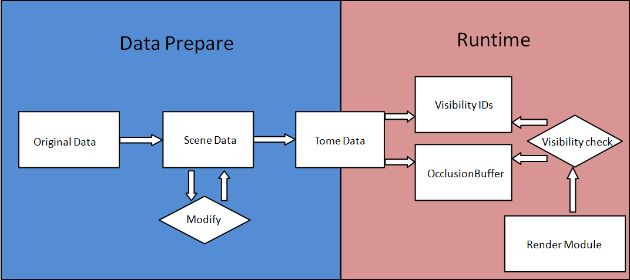
Umbra Pipeline
Original Data => Scene Data
Scene Data => Tome Data
Runtime Query

Slide 8
Original Data => Scene Data
API: Scene::insertObject
Main Params:
Id: The object's user ID. User ID's are used to identify the object
Flags: Bitmask of flags
SceneObject::OCCLUDER
SceneObject::TARGET
SceneObject::GATE
SceneObject::VOLUME

Slide 9
Scene Data => Tome Data
API：
Computation* computation = LocalComputation::create(localParams);
Computation::Result result = computation->waitForResult();
Main Params:
ComputationParams::COLLISION_RADIUS
ComputationParams::SMALLEST_HOLE
ComputationParams::SMALLEST_OCCLUDER
ComputationParams:: BACKFACE_LIMIT
ComputationParams:: OUTPUT_FLAGS
ComputationParams::DATA_TOME_MATCH

Slide 10
Runtime Query
API:
Query* query = new Query(tome);
query :: queryPortalVisibility
Main Params:
Flags: A bitmask of or'ed VisibilityQueryFlags values
VisibilityQueryFlags ::QUERYFLAG_IGNORE_CAMERA_POSITION
Visibility:out visible objInnerIds and OcclusionBuffer
Visibility (outputObjects, outputBuffer);
jobIndex & numJobs: for multithread process

Slide 11
Runtime Query
Visibility check with visibility IDs:
for each objInnerId in array outputObjects
Id = tome->getObjectUserID(objInnerId);
Visibility check with occlusionbuffer
bool outputBuffer ->isAABBVisible(v3mn, v3mx);

Slide 12
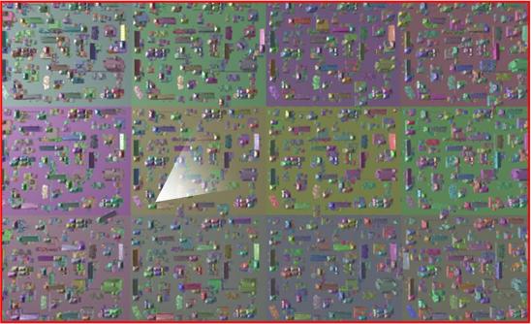
TomeCollection
Background
Big map=>big tome=>small tomes=> tomecollection

Slide 13
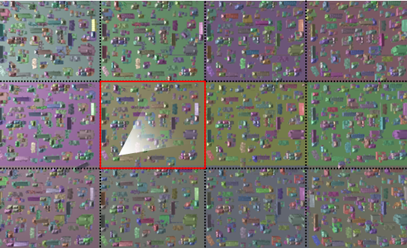
TomeCollection
Background
Big map=>big tome=>small tomes=> tomecollection

Slide 14
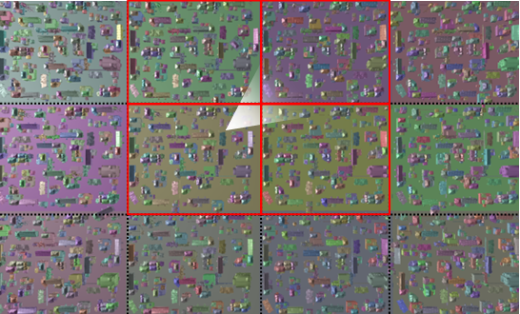
TomeCollection
Background
Big map=>big tome=>small tomes=> tomecollection

Slide 15
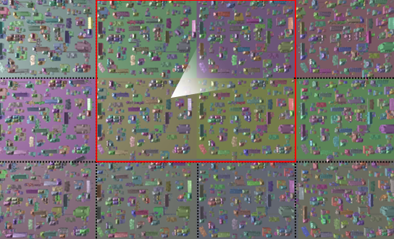
TomeCollection
Background
Big map=>big tome=>small tomes=> tomecollection

Slide 16
TomeCollection
Umbra Pipeline with TomeCollection
Original Data => Scene Data
Scene Data => Tome Data
Tome Data => TomeCollection
Runtime Query

Slide 17
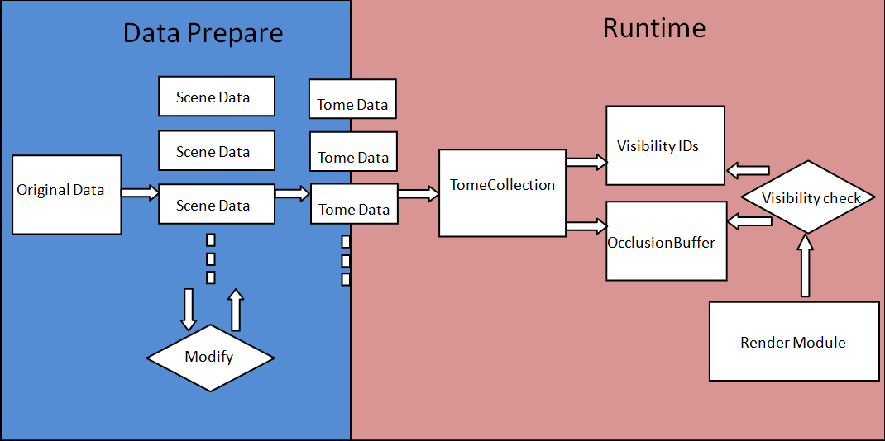
TomeCollection
Umbra Pipeline with TomeCollection

Slide 18
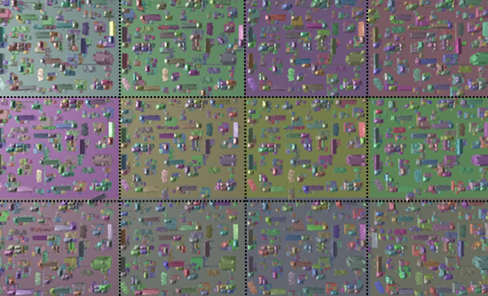
TomeCollection
Original Data => Scene Data
No overlap, can have gap

Slide 19
TomeCollection
Scene Data => Tome Data
ComputationParams::DATA_TOME_MATCH
Computation parameters need to be the same(☹)

Slide 20
TomeCollection
Tome Data => TomeCollection
API: TomeCollection:: build
Main params:
Tomes array
Previous tomecollection(not work ☹)

Slide 21
TomeCollection
Runtime Query
Create query from tomecollection instead of tome

Slide 22

Integrate to L.A.Noire
Section
Only available on editor, splits into several PVSCells
PVSCell (Potential visible section cell)
Low LOD

Slide 23
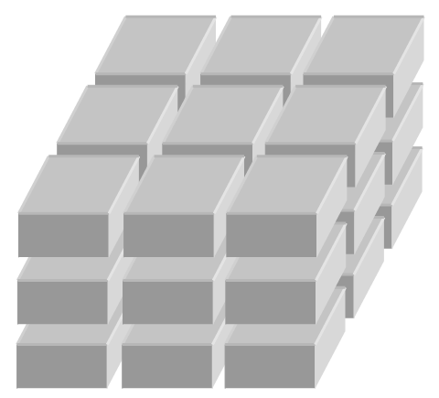
Integrate to L.A.Noire
PVSCell (Potential visible section cell)
High LOD

Slide 24

Integrate to L.A.Noire
PVSCell (Potential visible section cell)
Indoor

Slide 25
Integrate to L.A.Noire
Original Integration Method
Scene(tome) data per section
Use Section original data
Only use occlusionbuffer to cull
Final Integration Method
Scene(tome) data per PVSCells have same X,Z coordinate
Use high LOD and indoor original data
Use visibility IDs and occlusionbuffer to cull

Slide 26
Integrate to L.A.Noire
Integration Method for L.A.Noire VR(Paris team)
One scene(tome) data
Use low LOD original data
Only use occlusionbuffer to cull

Slide 27
Integrate to L.A.Noire
Integration Division
Data Integration(maxiao, lizhiyang):
PVSCell high lod data & indoor data => scene data => tome data => store in PVSCell data struct
Streaming Integration(guiqing)：
Load tome data with streaming system => build tomecollection
Query Integration(zhangheng)
Query tomecollection => visibility ids & occlusionbuffer => visibility check

Slide 28
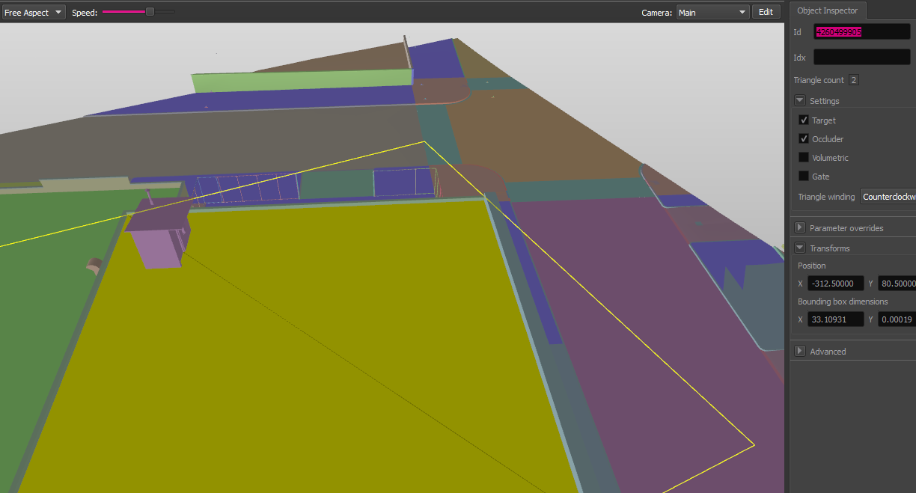
Data Integration
Umbra ID generate
X:8 Y:4 Z:8 Index:12
4260499905(X=-3:Y=-1:Z=33:Index=449)

Slide 29
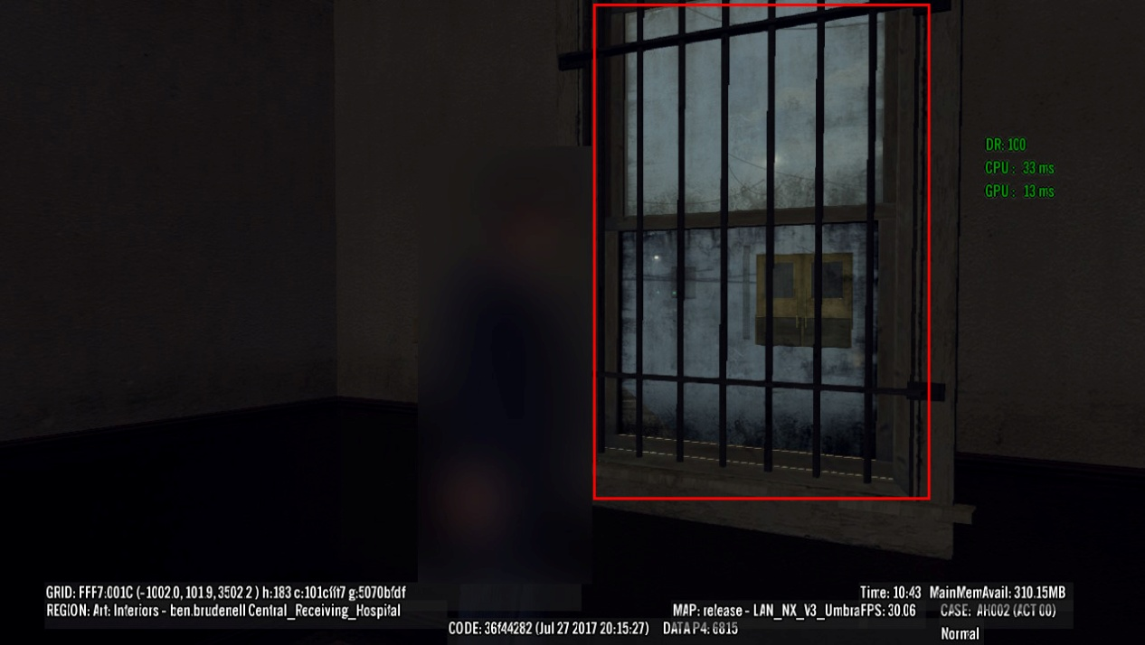
Data Integration
Deal with transparent object
Not add to scene by check the FLAGS_DEFFER_DRAW
Exception:

Slide 30
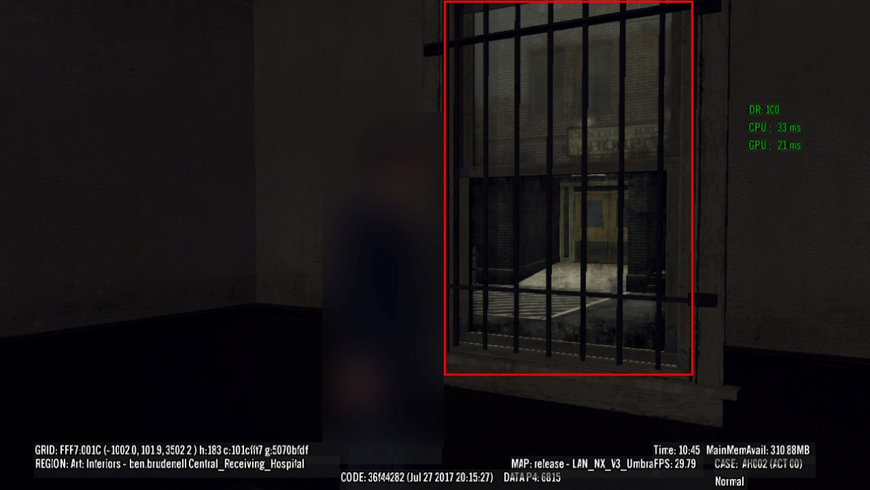
Data Integration
Deal with transparent object

Slide 31
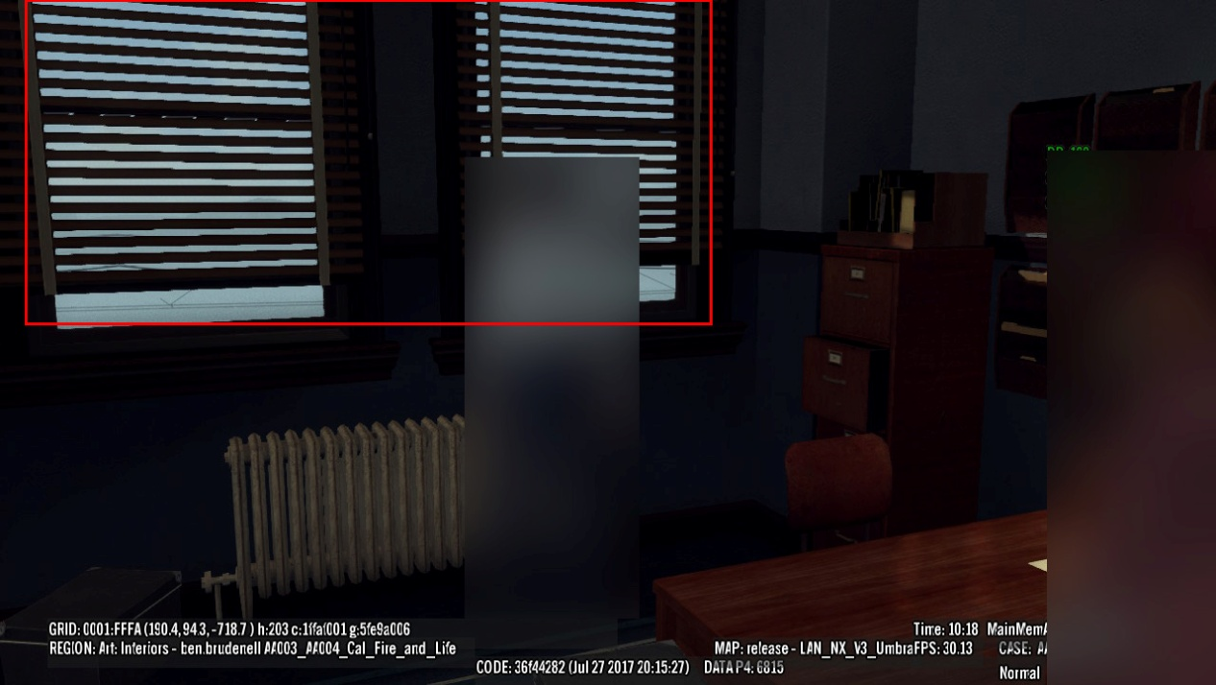
Data Integration
Deal with object with small hole
Change ComputationParams::SMALLEST_HOLE
Exception:

Slide 32
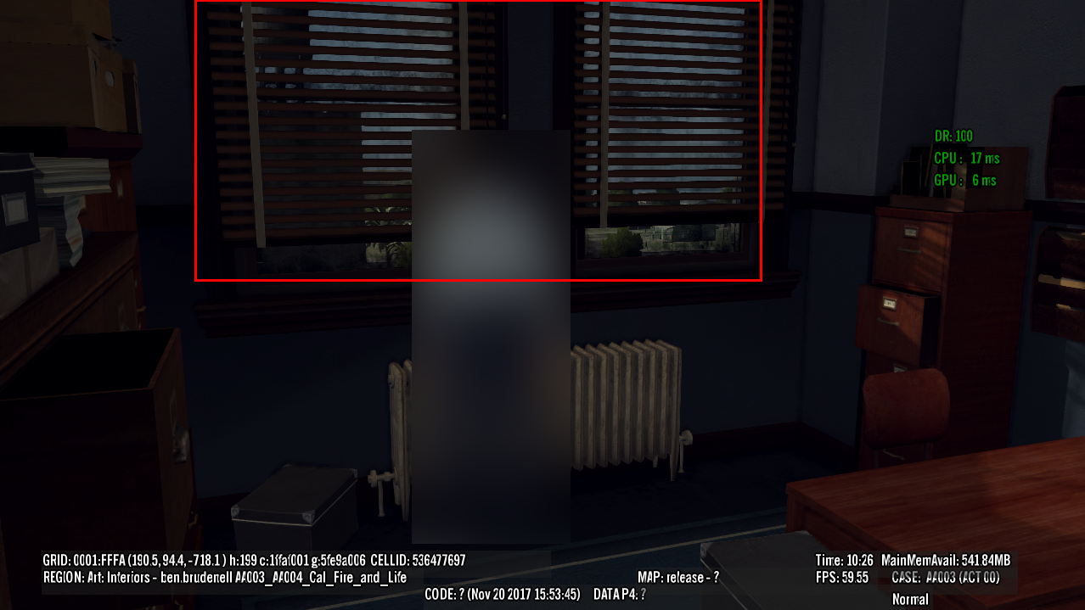
Data Integration
Deal with object with small hole

Slide 33
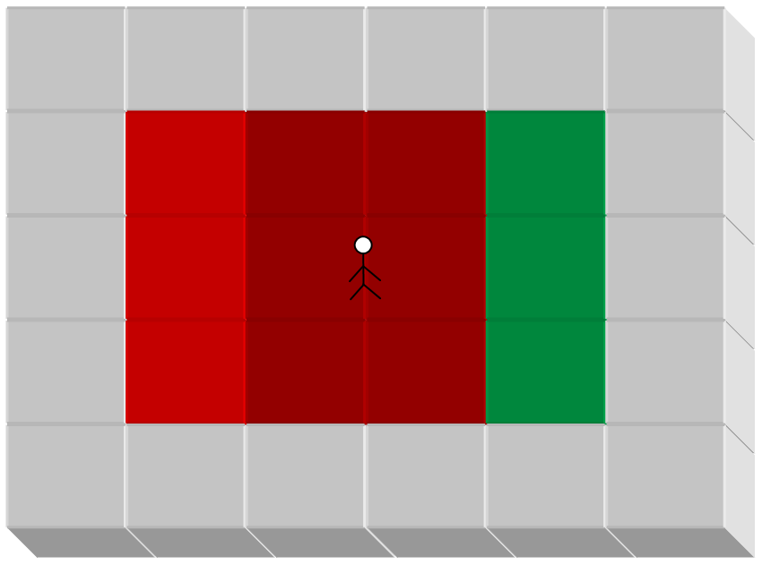
Streaming Integration
TomeCollection Streaming Model
3 x 3
Build new tomecollection when cross the PVSCell X,Z edge in background thread

Slide 34
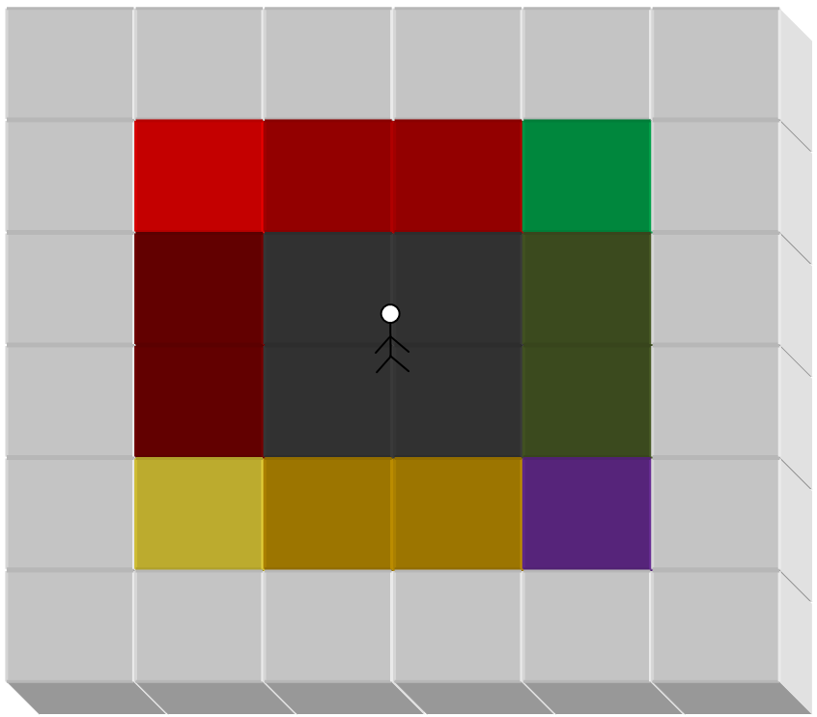
Streaming Integration
TomeCollection Streaming Model
4 tomecollections cache

Slide 35
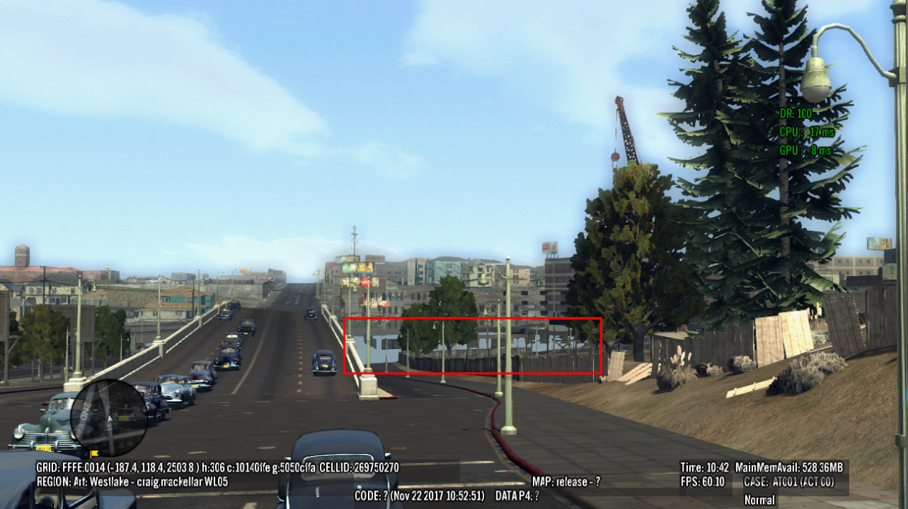
Streaming Integration
Integrate tome data into which PVSCell data struct
High LOD PVSCell?
Low LOD PVSCell?
Split by Y?

Slide 36
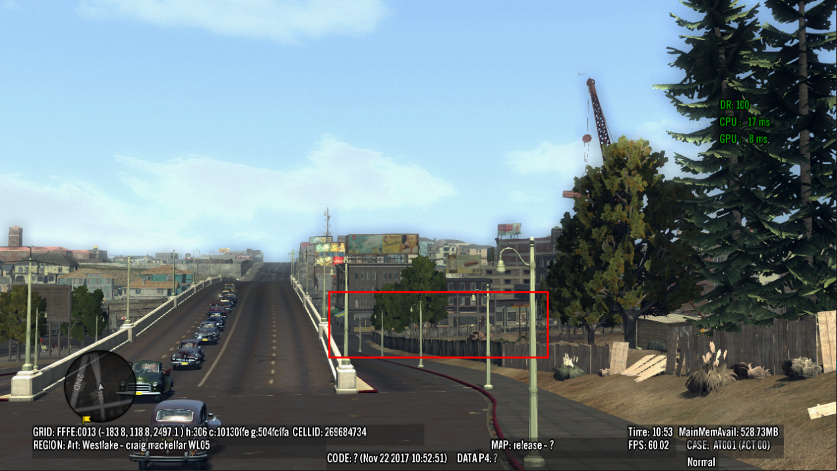
Streaming Integration
Integrate tome data into which PVSCell
Put into High LOD PVSCell
Y level which have most triangle count
Delay unload
Mark areas used by current tomecollection

Slide 37
Query Integration
queryPortalVisibility multi thread support
Run on 2 worker threads
Start task after camera update
Wait task finish before rendering

Slide 38
Query Integration
Visibility Check Optimization
Visibility IDs
Map Id (X, Z, Index) to a 3D bit array(3, 3, 4096)
Occlusionbuffer
No need to optimize

Slide 39
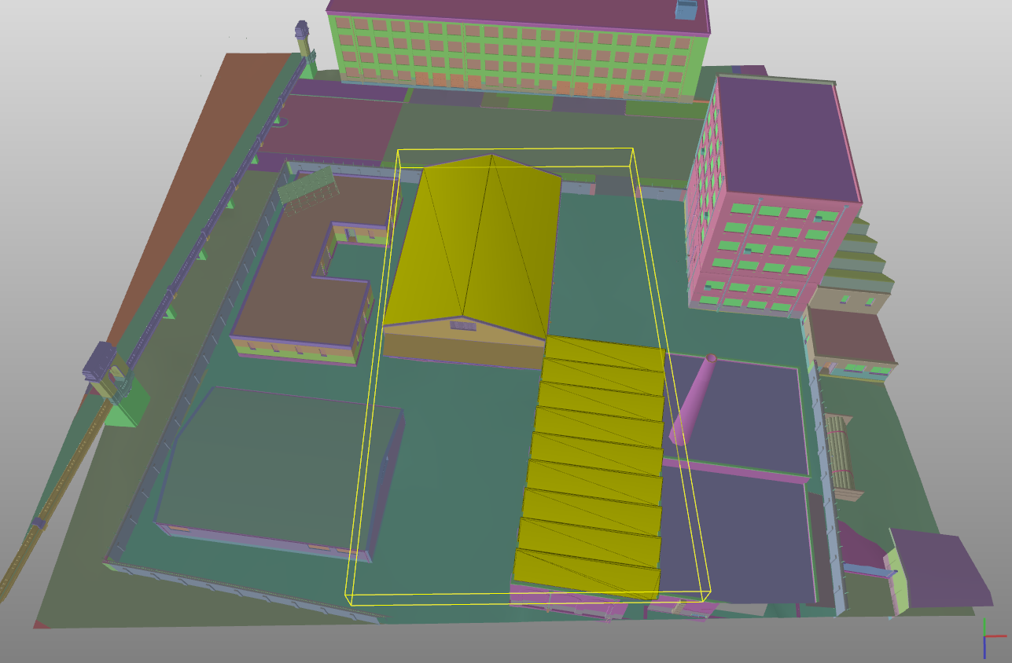
Other Issue
Conflict with render optimization

Slide 40
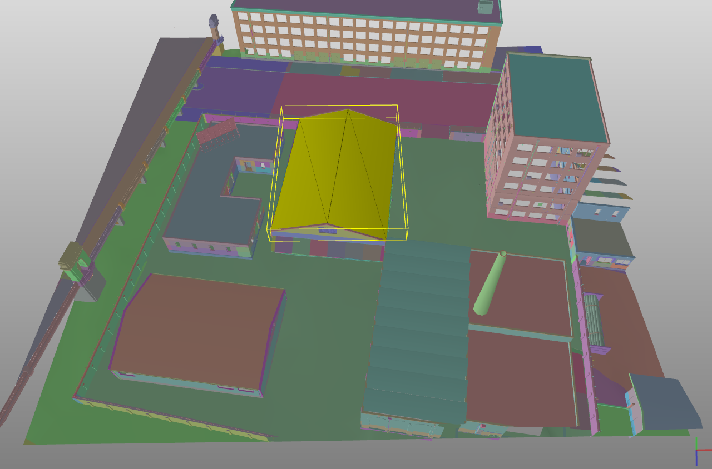
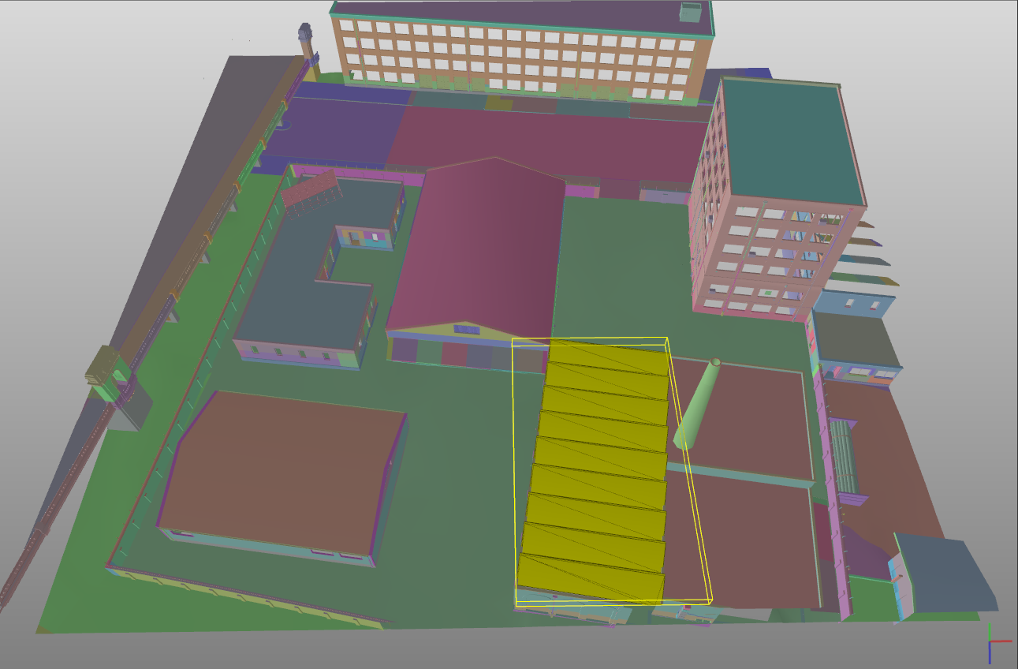
Other Issue
Conflict with render optimization

Slide 41
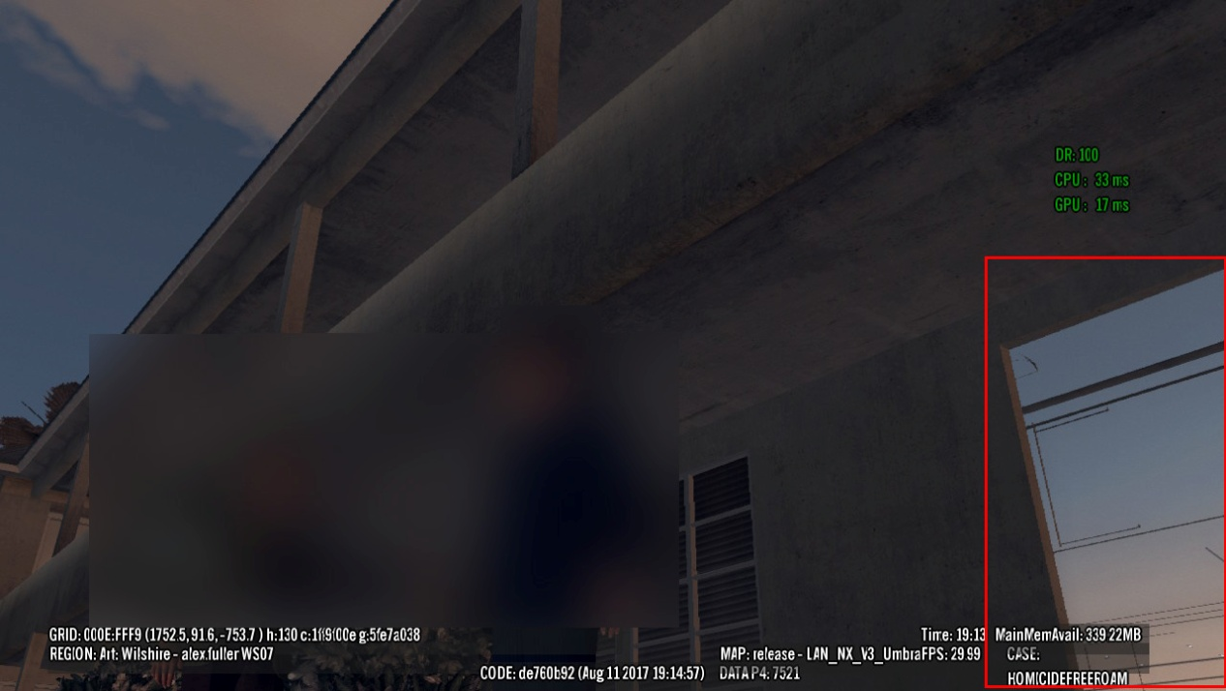
Other Issue
Edge issue

Slide 42
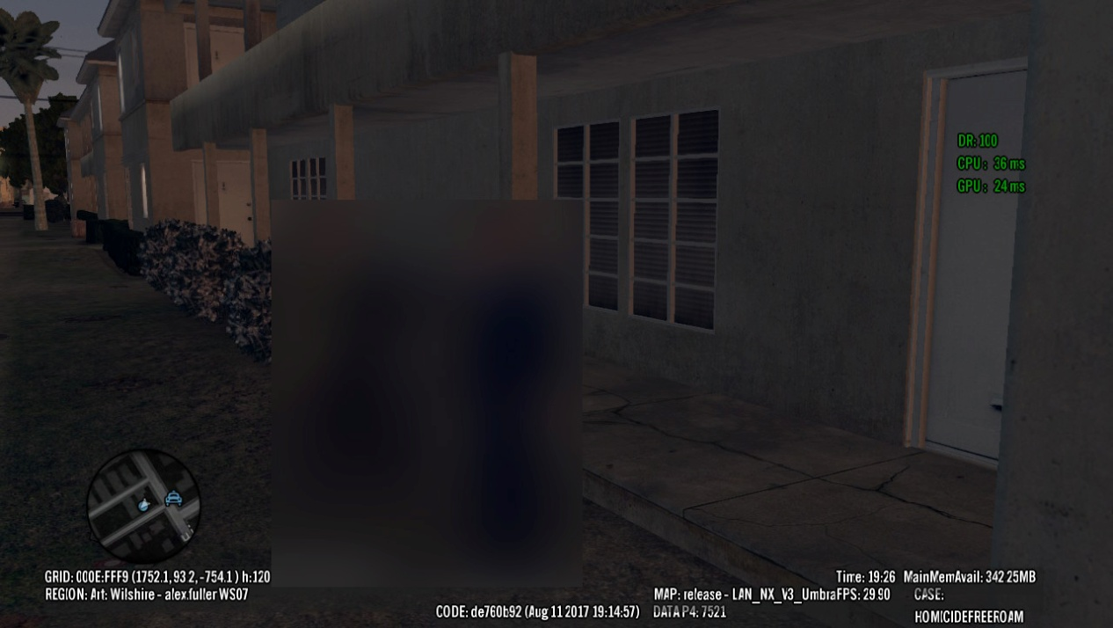
Other Issue
Edge issue

Slide 43
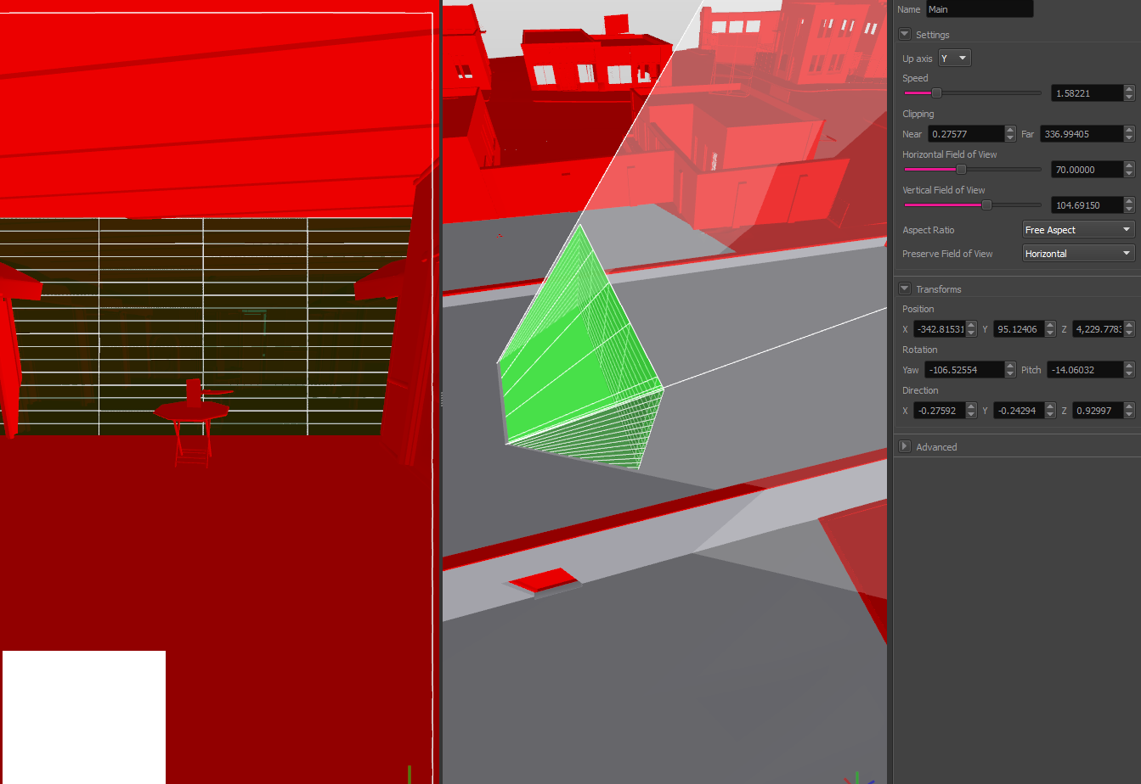
Other Issue
Umbra’s bug

Slide 44
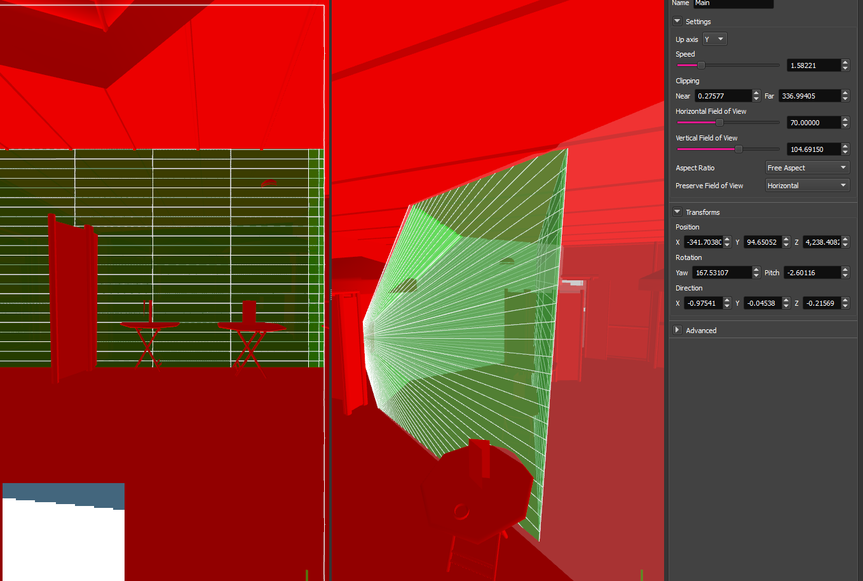
Other Issue
Umbra’s bug

Slide 45
Other Issue
Cutscene issue
Accuracy issue when camera is close to occluder

Slide 46
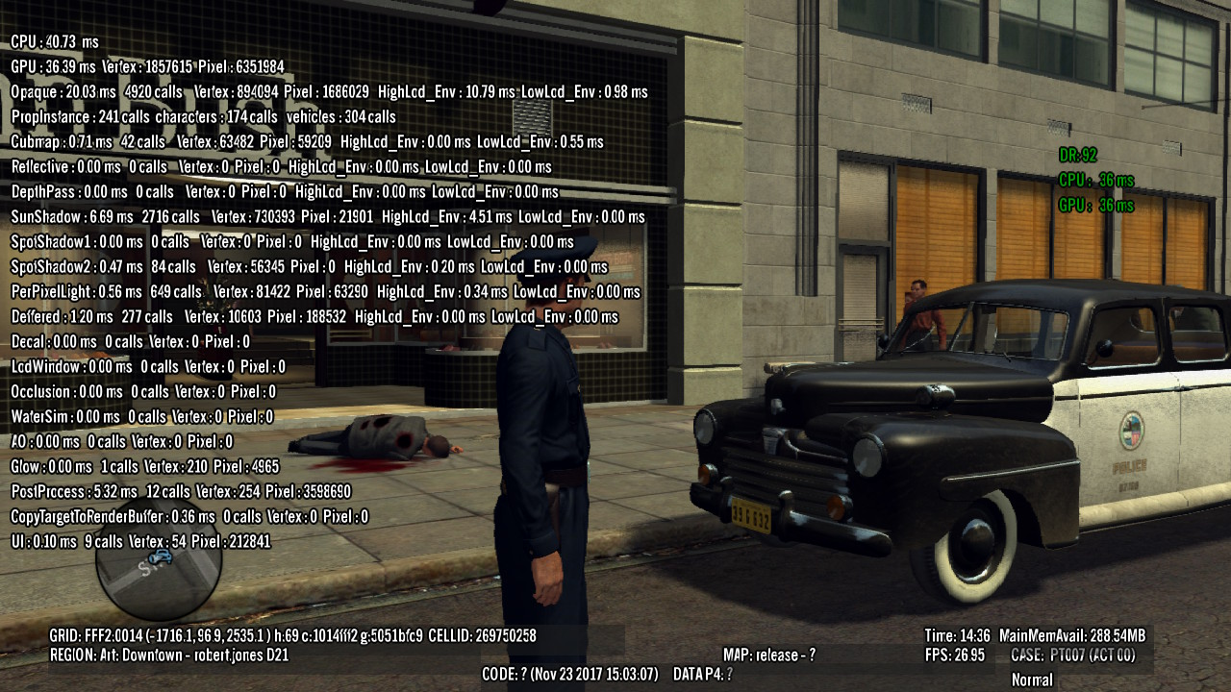
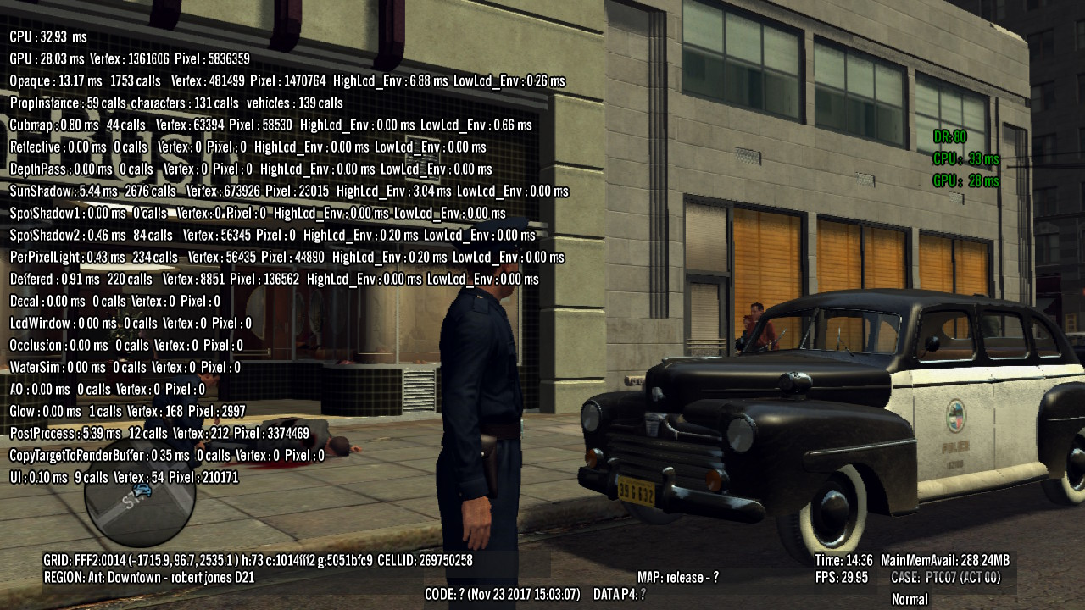
Conclusion
Compare between umbra on and off

Slide 47
Reference
https://en.wikipedia.org/wiki/Umbra_(3D_technology_company)
https://support.umbra3d.com/hc/en-us

